Slide 1
Title: Putting the Customer at the Center of Your Innovation Strategy
Abstract: How does a business develop new products that its customers need and want? In this session we'll discuss multiple customer first research methodologies that we used to evaluate new ideas and bring them to life successfully. We'll also review a recent product launch and highlight how our approach can be used by any team looking to innovate and bring customer-centric experiences to market.

Slide 2
Human Insight World 2020
Putting the Customer at the Center of Your Innovation Strategy
Mariko Frost, AD User Experience
The Hartford Small Business Innovation Lab

Slide 3
About Me
Harnessing user research for innovation
Adapting this process to a remote world
Q&A

Slide 4
About Me
Leading UX Research in The Hartford's Small Business Innovation Lab
Visiting Assistant Professor with the Pratt Institute School of Information
Fun fact: Images of my paintings were displayed on the side of the Google building in Chelsea last year!

Slide 5
About Us
The Hartford’s Small Business Innovation Lab
Strategists, researchers, and designers
Mission to better serve the insurance needs of small businesses
We conceptualize new ideas and nurture the most promising ones
Notes:
The Innovation lab is distinct in that we are primarily focused on the creation of new products, whereas in the main organization they are also responsible for maintaining and updating existing products. These methods can apply well to both, but are especially critical for new ideas, which cannot yet be steered with CX or analytics. These can also be great to use on existing products to find out the “why” behind areas of interest, substantiate expansions and product direction and prioritize goals.

Slide 6
Business challenge: “understand this”
Customer Service noticed construction professionals were dropping off while getting an insurance quote
Construction is a highly desirable industry for us
Contractor businesses tend to be smaller
Tasked with investigating this drop off

Slide 7
We conducted 5 studies to understand the customer need and define our solution
Discovery Interviews
Sacrificial Concepts
Card Sorting
Surveys
Usability Testing
(right) Volunteering in a construction space with our product owner, who is a subject matter expert

Slide 8
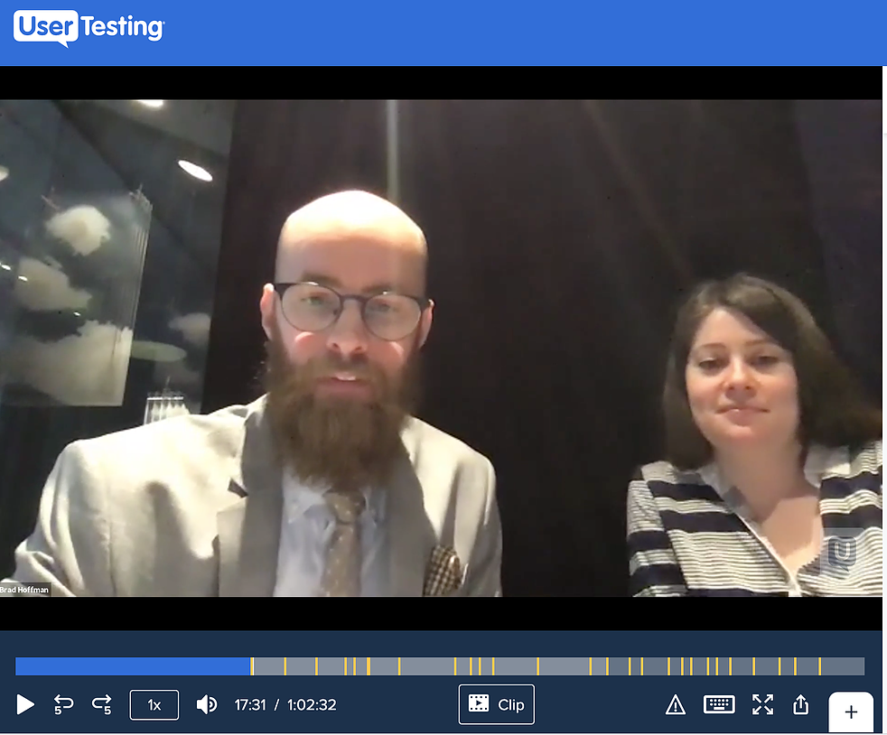
1. Discovery Interviews added clarity to the problem
Handymen work short projects, so long-term policies are too expensive and don’t meet their needs
They need a certificate of insurance (COI) to be considered for the most desirable jobs
Securing jobs requires following a specific set of steps – which we needed to understand and map
Notes:
We were able to map the order and ways in which they would find a job, quote the job, find out the project address, and go work on the project. One of the surprises was how often the contractors would need to pause work and go get an extra tool or something from the store. As this insurance is tied to the project address, this was interesting to note. Clients also cancelled less frequently than we had hypothesized.

Slide 9
2. Sacrificial concepts allowed us to prioritize ideas
“Please let me know your thoughts and reactions to these ideas”
Notes:
It saves design time to make quick ideas; and sacrificial concepts is an intermediary stage where you can get a quick response to a visual concept, or compare concepts. It’s like asking questions with images, and clients responses are more genuine when they have something more tangible and immediate to respond to. Sometimes we hand draw them – I think it’s best if they aren’t too precious.
By conducting this we got a better sense of which ideas and directions most appealed to them, and were able to hone in on the desirability of certain concepts by hearing participants talk through them. We were able to deprioritize tool rental, for example, after there didn’t seem to be any needs, motivations, or problems around insurance in that area.

Slide 10
3. Card sorting helped us speak their language
Things we learned
Preferred category names
Relationship between concepts for bucketing and copywriting
We needed to accommodate for spelling variations in our NLP model
While uncomfortably gendered, people do think of themselves as “handymen”
Notes:
We conducted an open card sort, where we present a list and users group them into categories and then write their own labels for the categories. Then we group together and assess the results. We looked at project names, categories for those projects, and what handymen call themselves and what they do.
Construction is an industry that I’m not super familiar with, and yet it's so critical for our team to speak their language. Especially in copywriting and information architecture, where participants will be looking for a word to complete their task. We want to make sure we’re using the right word that they will be looking for!
Interesting side note, although handymen is an uncomfortably gendered term, we tested lots of variations on this that were not recognized or used widely enough. For example, people saw ”handypeople” as accessibility related, and they saw the more gender neutral “contractors” as being more long-term-full-time-job related, so in the end we kept handymen but are still exploring more neutrally gendered possibilities, as men and women ended up being fairly equally interested.
Up next, our survey, is actually what confirmed our need for an NLP Model for inputs

Slide 11
4. Quantitative Surveys helped clarify the market opportunity
Who are the target
customers?
Define/refine the types of contractors most interested in this concept
How to prioritize opportunities?
Determine the size of different categories – turns out landscaping is huge!
Where to invest
resources?
Understand contractor’s use of technology to focus resources - Android!
Finding your product-market fit:
Qualitative research tells us what will be desirable to make, then quantitative research substantiates which customers to target.
Notes:
Interestingly, we found that although we were able to create best–fit category names through our open card sort in the previous study, people in the quant survey were not able to reliably self–classify within our specified error tolerance for actuarial rating. We found this out by asking people via open entry what they did, and then asking them to choose one of the job categories we previously found. Many mis-labeled themselves within a catch-all category such as “assembly”. This led to our exploration of an NLP model that interprets long entry text inputs and turns them into automatic categories – it performs well, which is a credit to our talented creative technologist.

Slide 12
5. Usability testing to optimize the solution
Once we had our scope and structure, we began blueprinting our visual design. We conducted usability tests to make sure it was performing as intended.
“Show me how you would get covered”
Notes:
For the few of you that have different backgrounds, a common question I get asked is, “What’s the difference between user testing and usability testing” User testing is the larger scope of all the different kinds of tests we can do with users; usability testing evaluates the functionality of a prototype or product, particularly its understandability and ease of use. Note that this is distinct from QA smoke testing, that makes sure all the links and things like that are not broken.
One tip I have around usability tests – is to base them on user tasks and then try to keep the tasks and questions consistent as you go up in fidelity. If the goals haven’t changed then keep the tasks consistent. That also helps designers from feeling they are being singled out!
Second tip: Make sure to prototype more than the “happy path”. It is a little more labor intensive, but you need to test an open world to really understand how people will move through the product.
Third tip: Don’t ask users to self rank or self rate, unless it is to understand their self perception against another metric of usability. Self perception is distinct from actual speed, use, and comprehension.
When presenting the test results, Ideally aim for about 50% positive and 50% critical feedback. Although I honestly rarely get to more than 30% positive, I’m working on it. It’s easier to see the problems sometimes than the things that are working well.

Slide 13
Key questions answered through our 5-step research
Value | Design | Go-to-Market | Bonus!
Confirmed that project-based insurance is desirable for handymen | Gathered insights to build a digital experience that solved real-world problems | Understood which customers, geographies and categories to launch first | Realized handymen describe their work differently, which led us to NLP
discovery interviews sacrificial concepts | discovery interviews usability testing | quant survey | card sorting quant survey

Slide 14
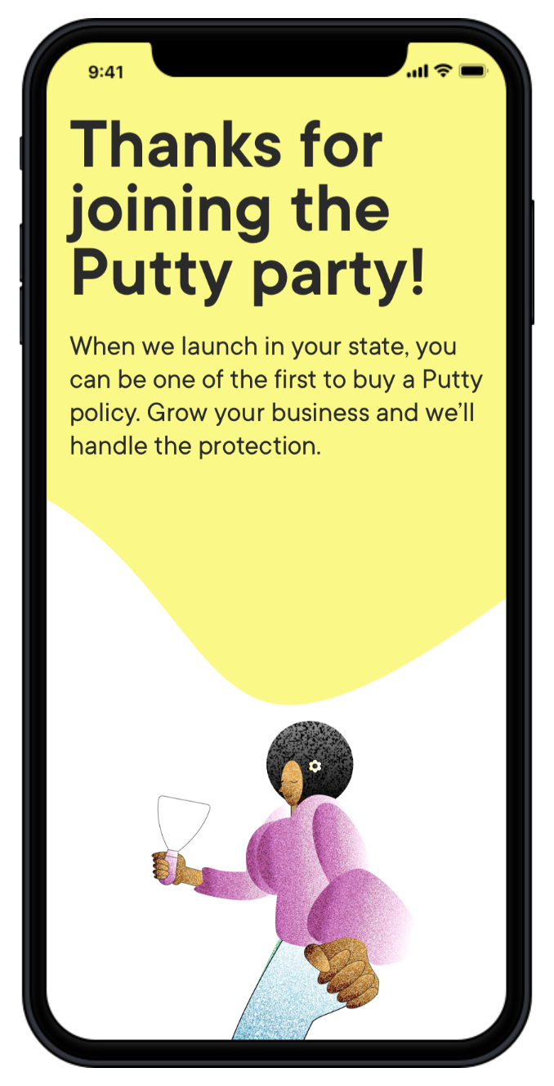
We got to make it!
If you want to see the result:
https://puttyinsurance.com/

Slide 15
Working in a remote world

Slide 16
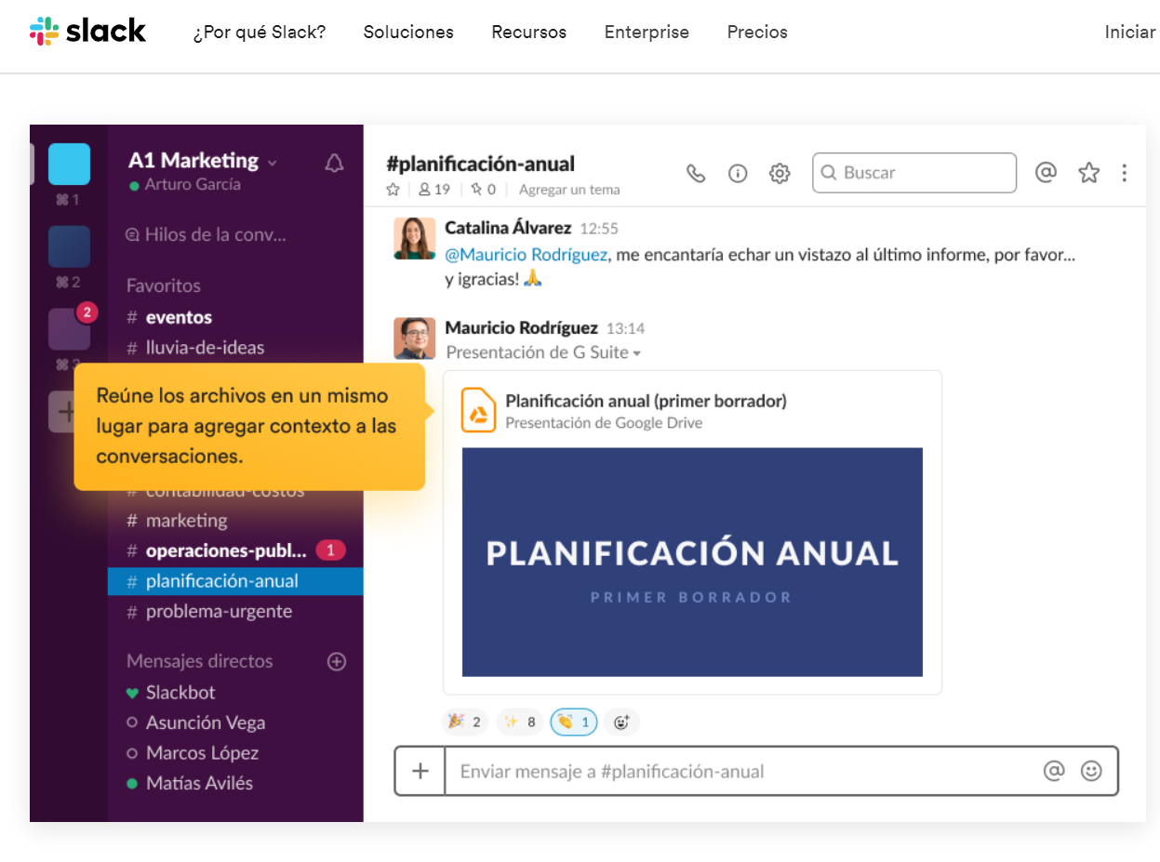
Shifting work culture to be more online
We found new ways to stay connected as a fully remote team
This involved:
Monthly mandatory fun
Weekly open office hours
Using Slack/Teams more
*If they feel comfortable
Not our actual Slack channels, but you get the idea

Slide 17
User research, remotely
Contextual analysis → Now online, we ask participants to show us around spaces with their phone*
Debrief by happenstance when we were co-located → Intentionally planned conversation
Usability testing and quant surveys → Pretty much the same!
*If they feel comfortable, of course

Slide 18
Mariko Frost
www.marikofrost.com/design
www.linkedin.com/in/mariko-frost-37044511

